Slide 1

Advanced Java
RECIPES STORE
by Yeldos Manap

Slide 2


Why we need this ?
It's hard to confront your desire to cook something delicious. But what if you lost the recipe? Or your grandma is too busy to answer a call and remind you of your favourite cake recipe.

Slide 3

Let's make a program that stores all recipes in one place. Create a multi-user web service with Spring Boot that allows storing, retrieving, updating, and deleting recipes.

Slide 4
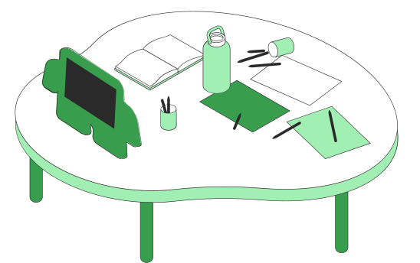
Practice Backend Development
Goals of project
Create REST API service
Add a database of recipes with kinda logic
Learn Spring dependencies (Security)
Authorization and Authentication System
Using data, develop Frontend side of project

Slide 5
Stages
1
2
3
4
5
First Recipe (Implement a simple JSON API that supports adding and getting a recipe)
Multiple recipes
Improve the web service to support multiple recipes
Store a recipes
Add a database to store and delete recipes
Sort & Update
Retrieve recipes by their category/name and update them if we need to
Additional things
Authorization, Spring Security, Frontend

